Slide 1

2024 Gender
Pay Gap
Report

Slide 2




About us
Founded in 1934 in Sweden, Securitas operates in 44 markets around the world, with over 341,000 employees.
Securitas is a leading intelligent security solutions partner. Our guarding, electronic security, fire and safety and risk management solutions enable more than 150,000 clients to see a different world.
We are present in 44 markets, and our innovative, data-driven approach makes us a trusted partner to many of the world’s best-known companies.
Our 341,000 employees live our values of integrity, vigilance and helpfulness and our purpose is to help make your world a safer place.
At Securitas, we support the fair treatment and reward of all our people, irrespective of gender.
We want to provide equal opportunities for all, creating a gender-balanced place to work where our people can shine and achieve their full potential.
These commitments, reinforced by our strong values, are embedded in our day-to-day working practices with our people, clients, and partners.
We are an inclusive employer, working towards a fully gender-balanced workforce, which represents all the communities that we serve.
This report summarises the positive improvements we have made and the actions we are taking to increase balanced gender representation in our teams, grow and support our internal pipeline of women progressing through the grades and attract more women to careers in the security industry.
This report provides details of the required statutory disclosures regarding gender statistics and pay data.
Sarah Hayes (Chartered FCIPD)
Human Resources Director, Securitas UK
Equal pay
Men and women will be paid the same for like-for-like work
The gender pay gap
Is the difference between the gross hourly earnings of men and women
1.2%
Overall, there has been a 1.2% drop
in the national median pay gap since last year
5.0%
At Securitas, there is a -5% mean pay gap and a -3.4% median pay gap in favour of women
0.7%
Our mean pay gap, whilst still in favour of women, has increased by 0.7% since last year

Slide 3
Pay quartile – gender profile 2024
Lowest
Lower-middle
Upper-middle
Upper
12.9%
13.6%
15.1%
19.2%
of women
of women
of women
of women
0.6%
2.5%
0.2%
1.5%
The median gender
pay gap by quartiles
Lowest quartile -0.4%
Lower middle quartile 0.5% Upper middle quartile -2.5% Upper quartile 2.2%
Up on
previous year
Up on
previous year
Down on previous year
Up on previous year

Slide 4


Pay quartile – gender pay gap
13.1%
The National median pay gap
-3.4%
Our median gender pay gap
-5%
Our mean gender pay gap
0.4%
0.7%
*Provisional ONS 2024 results
Down on
previous year
Up on
previous year
The gender pay gap is the difference between the gross hourly earnings of men and women.
Overall, there has been a 1.2% drop in the National median pay gap.
At Securitas, there is a -5% mean pay gap and a -3.4% median pay gap in favour of women.
Our mean pay gap is still in favour of women.

Slide 5




Bonus pay – gender profile
Securitas has a 0% gender pay gap in respect of the median for bonuses (a 93.8% change this year).
The gender pay gap in respect of the mean for
bonuses this year is 20.4%. This is a change from last year of 4.5%.
Factors affecting this variance include changes to the bonus scheme where commission is now available to a wider population.
24.4%
of males received a company bonus
30.4%
of females received a company bonus
0
Median gender bonus gap
20.4%
Mean gender bonus gap
£
0.3%
4%
93.8%
4.5%
Down on
previous year
Down on
previous year
Up on
previous year
Down on
previous year

Slide 6
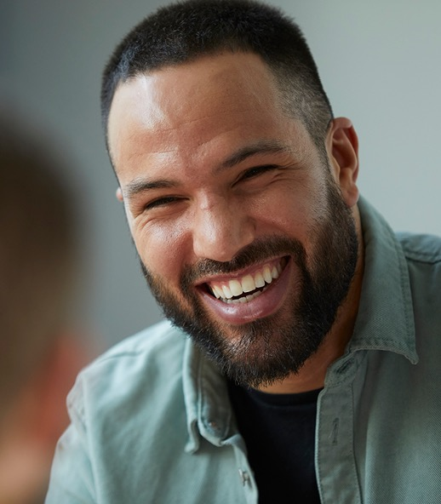
Gender pay report findings
In the 2024 data (reported April 2025) there was no gender pay gap in favour of men at Securitas.
This is consistent with the 2023 data (reported in March 2024).
Overall, we have increased our mean gender pay gap and decreased our median gender pay gap and statistically there is still a slight gap in favour of women.
This is because there are more men in the lowest and lower-middle quartiles than women.
Where women are under-represented, we see a minor gap which in reality equates to just a few pence per hour.
Securitas has made a commitment to work towards paying all employees the real Living Wage, at the end of 2024, 82% of our employees were paid at least the real Living Wage.
82%
of our employees were paid at least the real Living Wage.

Slide 7
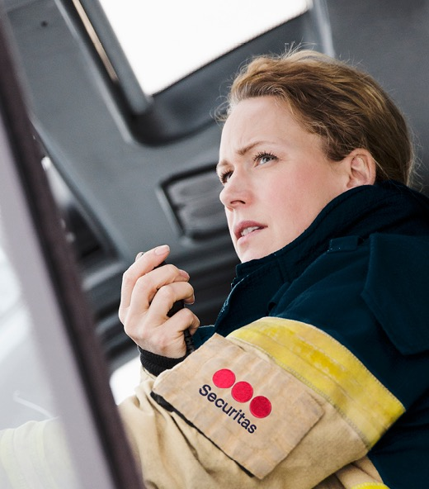
Addressing the gender pay gap
We are continuing our work to achieve a gender balanced workforce, attracting people from a wide range of diverse backgrounds.
Our work to date includes:
Introducing a job evaluation & market review tool for our indirect roles, this ensures that jobs are evaluated consistently & fairly
Using “gender decoder” software in recruitment to avoid gender bias
Our accelerator programme is a career development programme for people with protected characteristics who are committed to improving career opportunities & addressing perceived barriers
Continuing with our coaching & mentoring programme. This brings a wealth of expertise from various fields, offering personalised insights & support to help employees navigate challenges & achieve their goals
Achieving accreditation as a Top Employer every year since 2020
Improving policies that predominantly impact women such as menopause support, enhanced maternity pay & flexible working
STEM programme implemented in BAE electronic solutions providing internal development opportunities to lever 2 and 3 qualifications in engineering

Slide 8
Addressing the gender pay gap
We have the highest level of females in senior leadership roles than ever before and our next steps are:
Aspiration to increase the ratio of women at every level of our organisation
Review of recruitment advertising, utilising data available to us, making our advertising more attractive to women and drawing attention to traits that are important of security roles of today
Continue to roll out the job evaluation & market review tool for our direct roles, this will ensure that all jobs are evaluated consistently & fairly
Sharing our STEM programme experience and expanding the programme in collaboration with Securitas Technology
Utilising apprenticeships for parent or menopause returners to the workplace - reviewing the utilisation of local learning centres (ensuring we consider how we can do something similar where there are different apprenticeship levy rules - Scotland and NI)
Exploring whether there are any charities or companies that help women join the Security industry or return to the workplace that we could gift our apprenticeship levy to
Review of flexible working options and opportunities

Slide 9

Our values
Guide us in our daily business
Integrity
Vigilance
Helpfulness

